Slide 1
IT1007
TUTORIAL / LAB 4

Slide 2
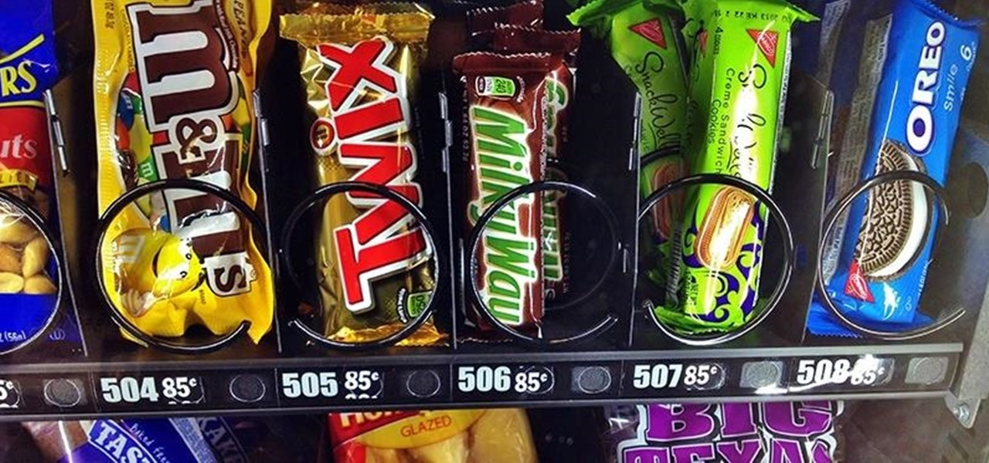

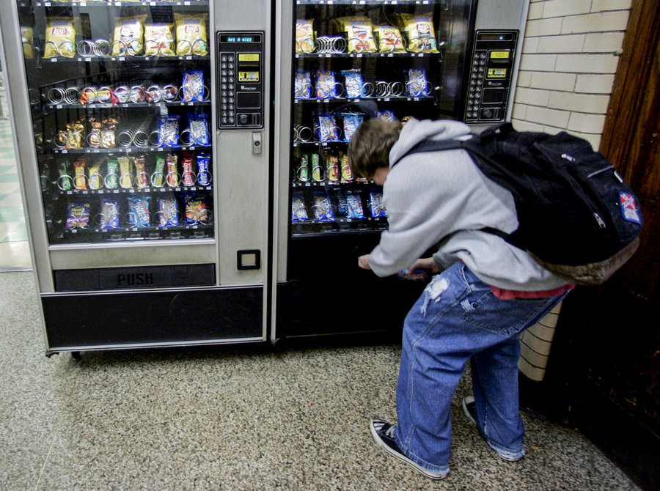
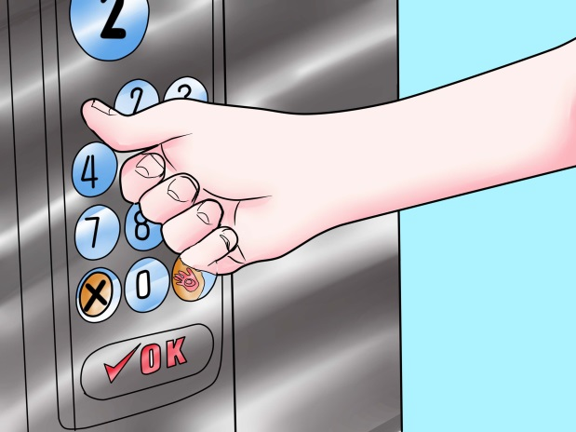

Recap: List
Or tuples
Index:
From 0 to len(a)-1
Input a number
Output an item

Slide 3
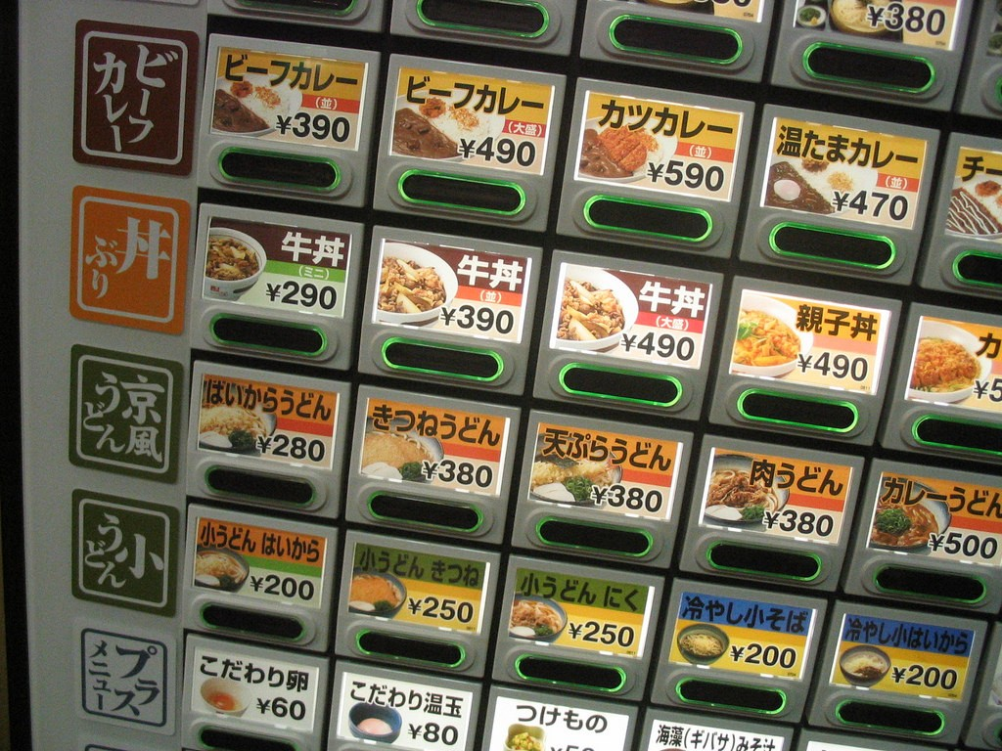
But when you go to Japan
You are not inputting a number (index)!
Input a number a name
Output an item

Slide 4
To set up a dictionary
Each pair has a key and a value
key
value
key
value

Slide 5

What is Dictionary?
Key is on the left, Value on the right
Summary: A data structure used for “When I give you X, give me Y”
Can store any type
Called HashTable in some other languages

Slide 6
How is a Dictionary Useful?
Keep Track of Things by Key!
Eg, keeping track of stocks of fruits
my_stock = {“apples”:450”,”oranges”:412}
my_stock[“apples”]
>>> 450
my_stock[“apples”] + my_stock[“oranges”]
>>> 862

Slide 7
How is a Dictionary Useful?
Keep Track of Things by Key!
When you want to get an associated operation (eg, alphabets to numeric integers)
my_alphabet_index = {‘a’:1,’b’:2… ‘z’:26}
my_alphabet_index[‘z’]
>>> 26

Slide 8
Dictionary Methods
Access (VERY FAST! - Almost instant!)
Assignment
Removal
Other Dictionary Methods

Slide 9
Dictionary Access
>>> my_fruit_inventory = {“apples”:450,”oranges”:200}
>>> my_fruit_inventory[“apples”]
450
>>> my_fruit_inventory.get(“apples”)
450
>>> my_fruit_inventory[“pears”]
KeyError!
>>> my_fruit_inventory.get(“pears”)
None
**Cannot access keys which don’t exist!**
Accessing with [] will crash if does not exist
Accessing with .get() will NOT crash if key does not exist

Slide 10
Dictionary Assignment
>>> my_fruit_inventory[“pears”] = 100
>>> print(my_fruit_inventory)
{“apples”:450, ”oranges”:200, “pears”:100}
Caution: This OVERWRITES existing values!
>>> my_fruit_inventory[“oranges”] = 100
>>> print(my_fruit_inventory)
{“apples”:450, ”oranges”:100, “pears”:100}

Slide 11
Dictionary Removal
>>> my_fruit_inventory = {“apples”:450,”oranges”:200}
>>> my_fruit_inventory.pop(“apples”)
>>> print(my_fruit_inventory)
{‘oranges’:200}
OR
>>> del my_fruit_inventory[“apples”]

Slide 12
Other Dictionary Methods
.clear()
.copy()
.keys()
.values()
.items()
clear all
make a copy
return all keys
return all values
return all keys + values

Slide 13
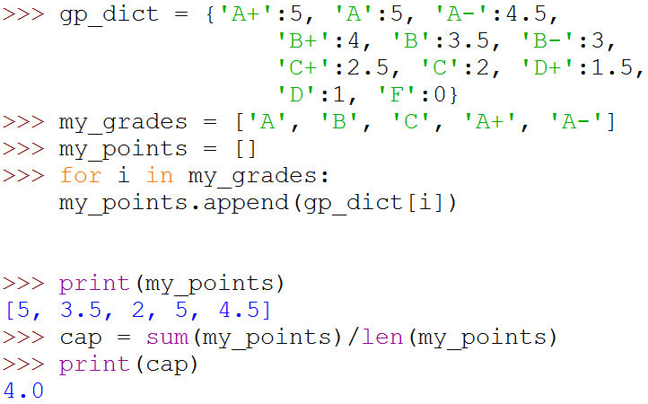
An Example of Dictionary

Slide 14

An Example of Dictionary
More compact code

Slide 15
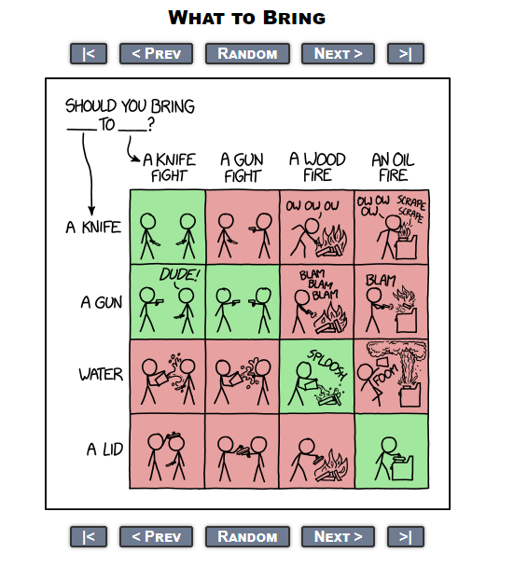

Advanced Example
XKCD comic
Should you bring ‘A LID’ to ‘A KNIFE FIGHT’?

Slide 16
We can create a 4 x 4 array of pics
But not cool to call a function:
should_we_bring(1,4)
0 1 2 3
0
1
2
3

Slide 17

Let’s do something like
should_we_bring[‘A GUN’][‘A KNIFE FIGHT’]

Slide 18
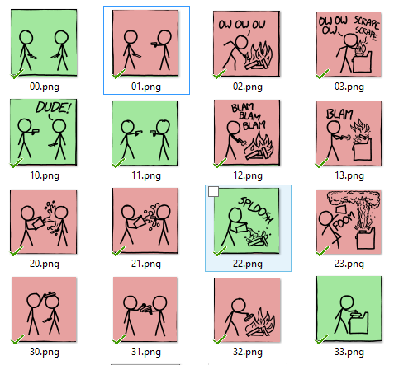
First I save the pictures into…
XY.png
X, Y in [0..3]

Slide 19
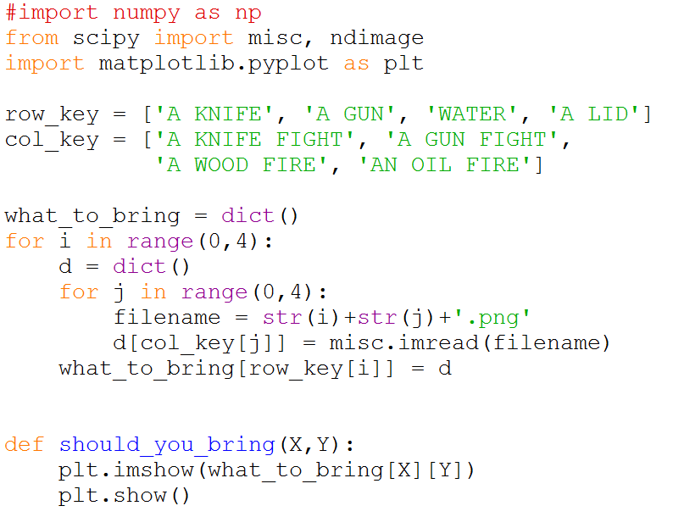
Then I wrote my code

Slide 20
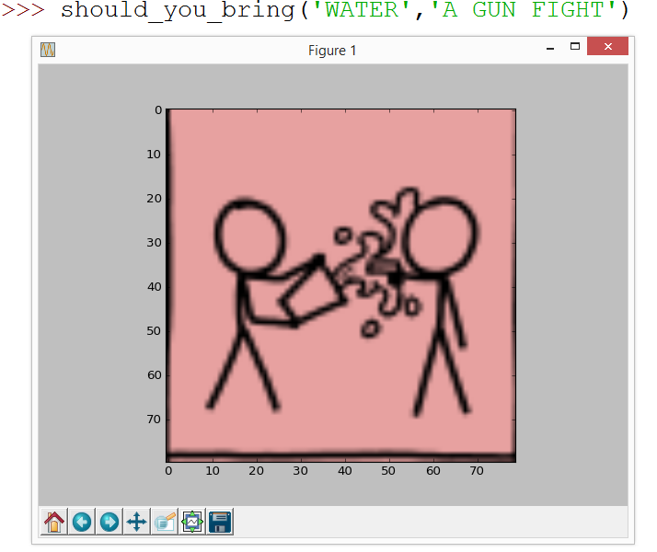

Slide 21
File I/O
CSV vs non-CSV

Slide 22
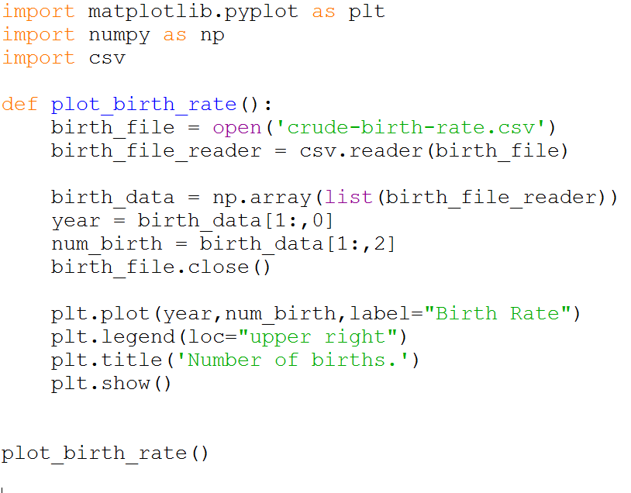
All you need to use in order to read an entire CSV file into a numpy array

Slide 23
In Short, Reading a CSV file
import csv
import numpy as np
f = open(‘csv file name’)
f_reader = csv.reader(f)
data = np.array(list(f_reader))

Slide 24
Reading A Non-CSV file
with open(‘some file name’) as f:
for a_line in f:
work on the string a_line

Slide 25
Lab Time
Tips
If you have trouble with the program you can either:
Use the Python debugger, or….
print everything! every “i”, every “n”, etc..

